Slide 1

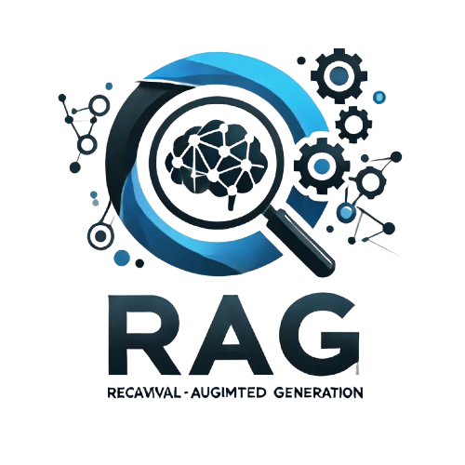

RESEARCH-GPT
NLP RESEARCH PAPER INSIGHTS
PRESENTED BY:
TEAM TRANSFORMERS
Notes:
Good [morning/afternoon], today I'll present ReSearchGPT, a Retrieval-Augmented Generation system that answers queries based on insights from the latest NLP research papers.

Slide 2





Our team
01/10
NIHANTH KOLLURU
AMRUTH KUNTAMALLA
JULES R CAYER
SRAVAN GOGINENI

Slide 3


01 | Topic
02 | Objectives
03 | Value Proposition
04 | State-of-the-Art-RAG Analysis
05 | Approach
06 | Deliverables
07 | Evaluation Methodology
08 | Conclusion
Agenda

Slide 4
Overview
03/10
Develop a Retrieval-Augmented Generation (RAG) system to retrieve and generate insights from the latest NLP research (post-January 2024). The system will evaluate two retrieval mechanisms to answer domain-specific questions:
Vector Search: Dense vector representations for semantic search.
Hybrid Search: Combines dense and sparse retrieval
Domain Corpus
Corpus: 100+ latest NLP research papers (post-January 2024).
Sources: ArXiv, Springer, Semantic Scholar, etc.
Focus: Emerging NLP techniques like transformers, language models, and multi-modal learning.
Characteristics: Cutting-edge, diverse topics in NLP
Notes:
With NLP research rapidly expanding, it's increasingly difficult for researchers to stay updated. ReSearchGPT aims to automate retrieval and summarization from recent papers

Slide 5


04/10
Objectives and Goals
Goal # 1
Goal # 2
Goal # 3
Develop a RAG System: Integrate the latest NLP research to answer domain-specific queries.
Evaluate Retrieval Mechanisms: Compare Vector Search
Assess responses from Gemini_Flash,LLaMA and Deepseek using the same retrieval mechanism.
Notes:
Our key objectives were to design a system that automates the process of retrieving and summarizing insights from the latest NLP research.
We aimed to handle over 100 papers, answer open-ended queries with factual accuracy using LLMs, and validate the quality of the system using ROUGE scores.
The overall goal is to offer a scalable pipeline for research Q&A, which can be improved or extended in the future

Slide 6

Value Proposition
05/10
Up-to-date Insights: Provides real-time access to NLP research published after January 2024.
Evaluation of Retrieval Methods: Compares Vector to assess their impact on NLP tasks.
Real-World Application: Useful in research assistance, academic tools, and knowledge management.
Open-Source Contribution: Leverages open-source LLMs for scalable, accessible solutions.
Notes:
Our system helps researchers by drastically reducing the time needed to search and read papers while ensuring answers are up-to-date and context-rich

Slide 7

State-of-The-Art RAG Analysis
06/10
Vector vs. Hybrid Search – Vector captures semantics; hybrid merges dense & sparse for better accuracy.
Cross-Encoder Search – Jointly encodes query-document pairs for precise relevance.
RAG Architecture – Retriever fetches docs; LLM generates responses.
Latest RAG Models – xRAG boosts compression; VERA refines retrieval & accuracy.
Relevant Works:
Lewis et al., 2020 – RAG: Retrieval-augmented generation for knowledge-intensive NLP. NeurIPS.
Karpukhin et al., 2020 – Dense Passage Retrieval for open-domain QA. EMNLP.
Izacard et al., 2021 – Leveraging passage retrieval with generative models for QA. NAACL.
Thakur et al., 2021 – BEIR: Benchmark for zero-shot retrieval evaluation. NeurIPS.
Notes:
RAG systems like Facebook's RAG and GPT-Retrieval blend retrieval and generation. However, they can suffer if initial retrieval isn't strong enough, affecting the final answer quality.

Slide 8

Approach
07/10
LLMs: Gemini-Flash,LLaMA, Deepseek.
Datasets: 100+ latest NLP papers (ArXiv, ACL, Semantic Scholar, post-Jan 2024).
Preprocessing: Convert PDFs/texts into chunks, extract key sections, store in postgress.
System Architecture:
Data Ingestion: Scrape, preprocess, and embed papers using Sentence Transformers/BERT.
Retrieval: Vector Search via Pinecone
Generation: Use Gemini_Flash/LLaMA/Deepseek with retrieved data for responses.
Evaluation: Compare LLMs based on retrieval-enhanced responses.
Notes:
We deployed all services onto AWS to ensure scalability, availability, and robust backend support.
For semantic search, we chose Pinecone, a high-performance vector database, to store and query paper embeddings effectively.
When a user submits a query, our system searches the vector database for the most relevant paper chunks based on semantic similarity.
These retrieved documents are then passed to a Gemini_flash,LLaMA,Deepseek language model, which generates a final, coherent answer conditioned on the context.
Throughout the system, we exclusively relied on vector-based retrieval without applying hybrid reranking methods, ensuring simplicity and focus on retrieval quality

Slide 9

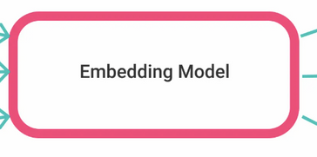
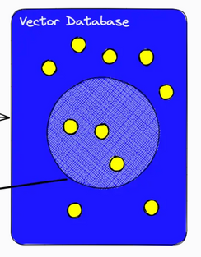

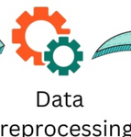


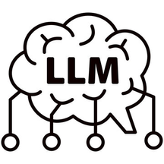
Architecture
10/10
Documents
Query
Answer
Notes:
Here's a visual overview of our system: from collecting papers to processing them, generating embeddings, retrieving relevant context, and using an LLM for answer generation."

Slide 10
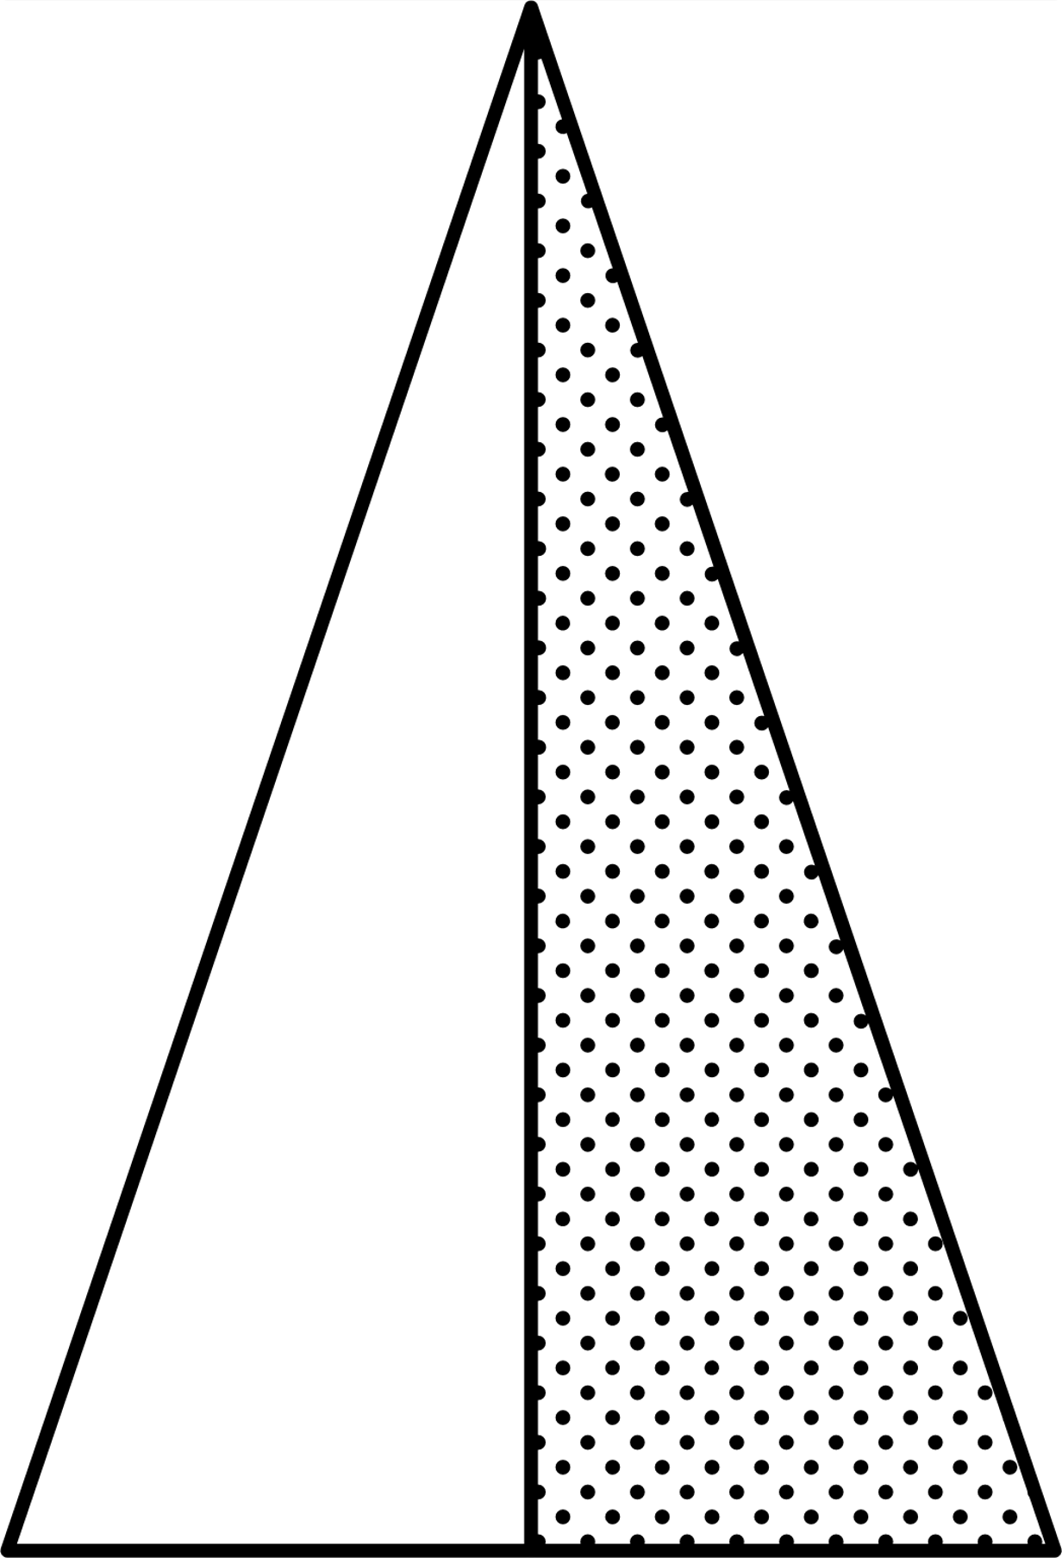
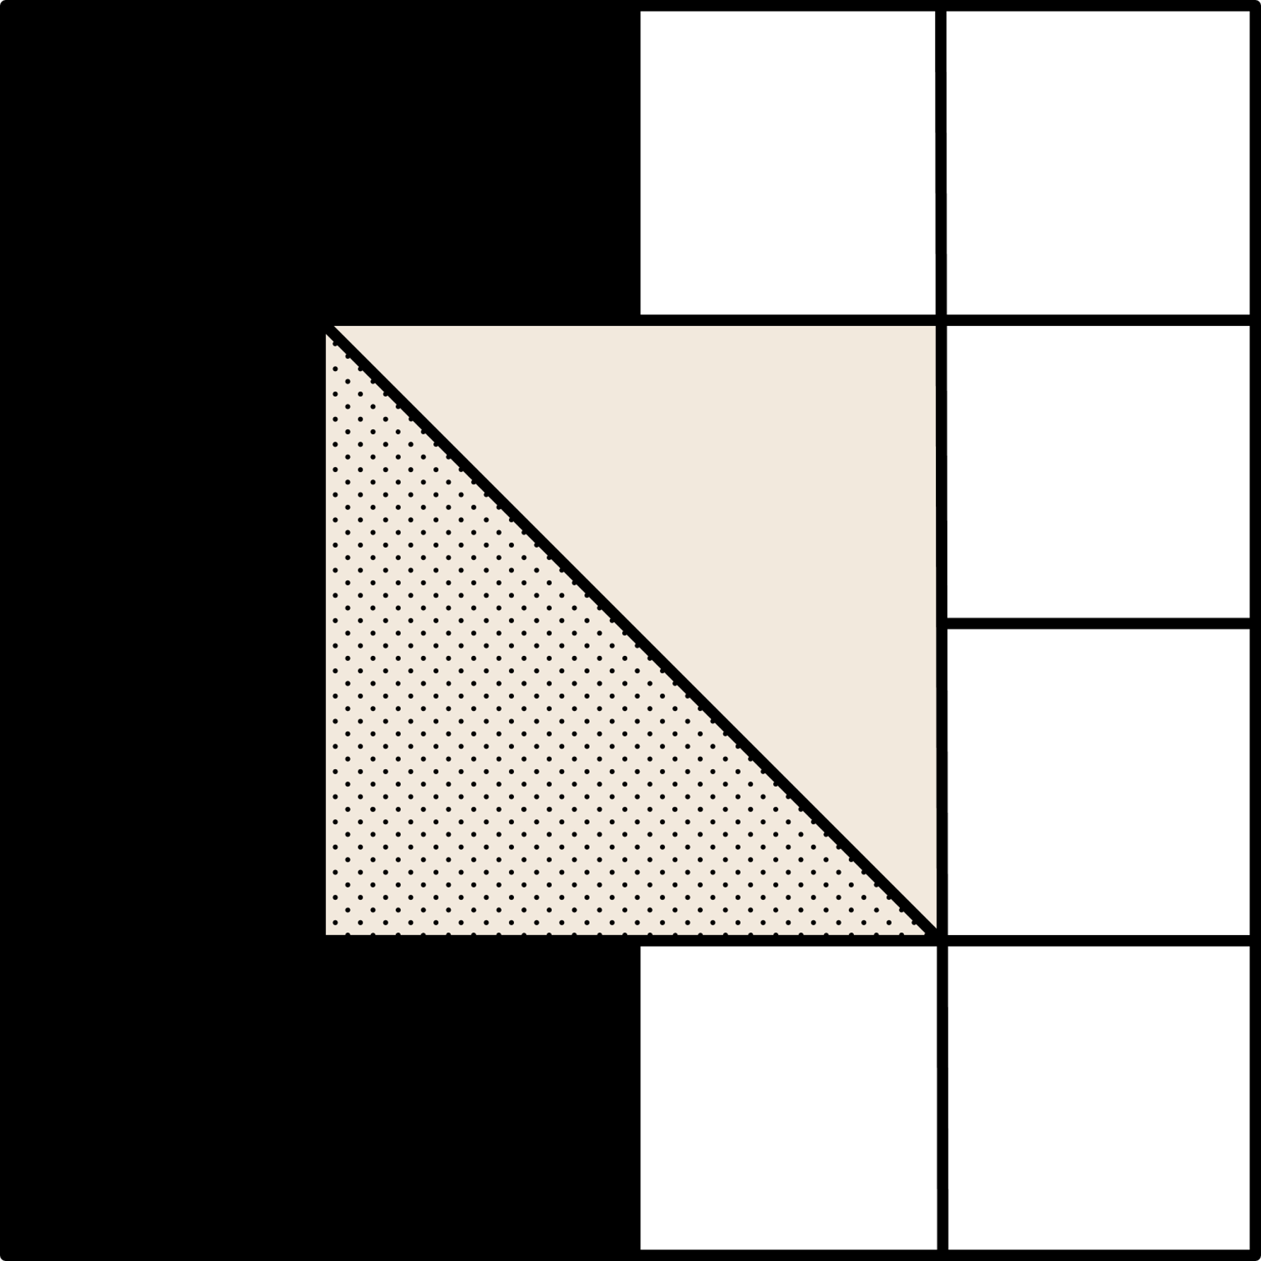
Deliverables
08/10
RAG
System
GitHub Repository
Evaluation Metrics
Notes:
Our deliverables include the full retrieval-generation system, the generated answers for various queries, and a detailed evaluation based on ROUGE scores.

Slide 11

Evaluation Methodology
09/10
Response Quality((ROGUE score)): Evaluate relevance, accuracy, and completeness.
Hallucination Rate: Measure incorrect facts in retrieval methods.
Precision and Recall: Assess relevant document identification.
Factual Accuracy: Compare answers to expert data.
Latency and Efficiency: Measure retrieval and generation time.
Notes:
We used ROUGE scores to assess the quality of our generated answers, evaluating n-gram overlaps and how much meaningful information is retained.

Slide 12
10/10
CONCLUSION
ReSearchGPT: effective RAG for research insights
Future improvements: better retrieval filtering, multimodal ingestion (text + figures)
Notes:
In summary, ReSearchGPT shows promising results for NLP research automation. Future directions include enhancing retrieval quality and supporting multimodal content like texts, figures and supporting documents.

Slide 13
10/10
Thank you

